Slide 1
Computer Organization and Design Representing Operands
Montek Singh
Jan 27, 2016
Lecture 3

Slide 2
Representing Operands
Characters
Integers
Positive numbers
Negative numbers
Non-Integers
Fixed-Point Numbers
Floating-Point Numbers
Reading:
Chapter 2.3-2.4
Chapter 3.5 (only through pg. 202)

Slide 3
Motivation
Computer use binary representation internally
a wire is “hot” or “cold”
a switch is “on” or “off”
How do we use bits to represent information?
We need standards of representations for
Letters
Numbers
Colors/pixels
Music
Video
…

Slide 4
Information Encoding
Encoding = assign representation to information
Examples:
suppose you have two “things” (symbols) to encode
one is  and other 
what would you do?
now suppose you have 4 symbols to encode
h, d, b and z
what would you do?
now suppose you have the following numbers to encode
1, 3, 5 and 7
what would you do?

Slide 5
Encoding is an art
Choosing an appropriate and efficient encoding is a real engineering challenge (and an art)
Impacts design at many levels
Complexity (how hard to encode/decode)
Efficiency (#bits used, transmit energy)
Reliability (what happens with noise?)
Security (encryption)

Slide 6
Fixed-Length Encodings
What is fixed-length encoding?
all symbols are encoded using the same number of bits
When to use it?
if all symbols are equally likely (or we have no reason to expect otherwise)
When not to use it?
when some symbols are more likely, while some are rare
what to use then: variable-length encoding
example:
suppose X is twice as likely as Y or Z
how would we encode them?

Slide 7
Fixed-Length Encodings
Length of a fixed-length code
use as many bits as needed to unambiguously represent all symbols
1 bit suffices for 2 symbols
2 bits suffice for …?
n bits suffice for …?
how many bits needed for M symbols?
ex. Decimal digits 10 = {0,1,2,3,4,5,6,7,8,9}
4-bit binary code: 0000 to 1001
ex. ~84 English characters = {A-Z (26), a-z (26), 0-9 (10), punctuation (8), math (9), financial (5)}
7-bit ASCII (American Standard Code for Information Interchange)

Slide 8
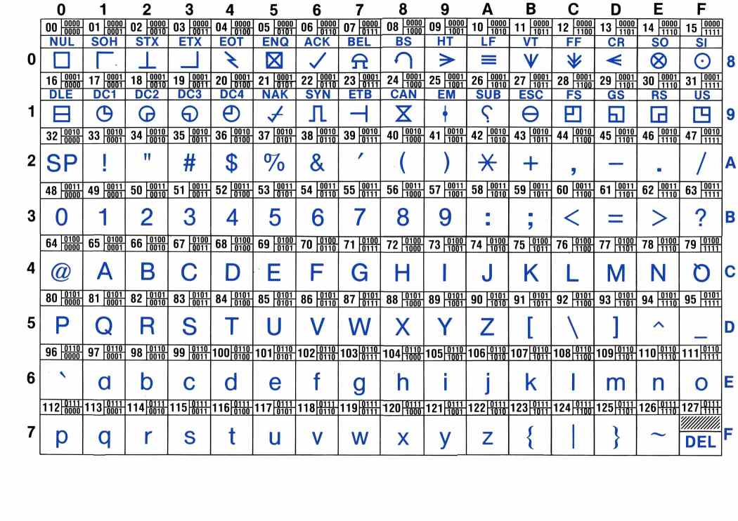
Encoding Characters
ASCII Code: use 7 bits to encode 128 characters

Slide 9
Encoding More Characters
ASCII is biased towards western languages, esp. English
In fact, many more than 256 chars in common use: â, m, ö, ñ, è, ¥, 揗, 敇, 횝, カ, ℵ, ℷ, ж, ค
Unicode is a worldwide standard that supports all languages, special characters, classic, and arcane
Several encoding variants, e.g. 16-bit (UTF-8)
ASCII equiv range:
0
x
x
x
x
x
x
x
16-bit Unicode
1
1
0
y
y
y
y
x
1
0
x
x
x
x
x
x
24-bit Unicode
1
1
1
0
z
z
z
z
1
0
z
y
y
y
y
x
1
0
x
x
x
x
x
x
1
1
1
1
0
w
w
w
1
0
w
w
z
z
z
z
1
0
z
y
y
y
y
x
1
0
x
x
x
x
x
x
32-bit Unicode

Slide 10
Encoding Positive Integers
How to encode positive numbers in binary?
Each number is a sequence of 0s and 1s
Each bit is assigned a weight
Weights are increasing powers of 2, right to left
The value of an n-bit number is
2¹¹
2¹⁰
2⁹
2⁸
2⁷
2⁶
2⁵
2⁴
2³
2²
2¹
2⁰
0
1
1
1
1
1
0
1
0
0
0
0
2⁴ = 16
+ 2⁶ = 64
+ 2⁷ = 128
+ 2⁸ = 256
+ 2⁹ = 512
+ 2¹⁰ = 1024
2000_{ten}

Slide 11
Some Bit Tricks
Get used to working in binary
Specifically for Comp 411, but it will be helpful throughout your career as a computer scientist
Here are some helpful guides
Memorize the first 10 powers of 2
2⁰ = 1 2⁵ = 32
2¹ = 2 2⁶ = 64
2² = 4 2⁷ = 128
2³ = 8 2⁸ = 256
2⁴ = 16 2⁹ = 512

Slide 12
More Tricks with Bits
Get used to working in binary
Here are some helpful guides
2. Memorize the prefixes for powers of 2 that are multiples of 10
2¹⁰ = Kilo (1024)
2²⁰ = Mega (1024*1024)
2³⁰ = Giga (1024*1024*1024)
2⁴⁰ = Tera (1024*1024*1024*1024)
2⁵⁰ = Peta (1024*1024*1024*1024*1024)
2⁶⁰ = Exa (1024*1024*1024*1024*1024*1024)
For fun: http://highscalability.com/blog/2012/9/11/how-big-is-a-petabyte-exabyte-zettabyte-or-a-yottabyte.html

Slide 13
Even More Tricks with Bits
Get used to working in binary
Here are some helpful guides
01
0000000011
0000001100
0000101000
When you convert a binary number to decimal, first break it down into clusters of 10 bits.
Then compute the value of the leftmost remaining bits (1) find the appropriate prefix (GIGA) (Often this is sufficient)
Compute the value of and add in each remaining 10-bit cluster

Slide 14
Other Helpful Clusterings
Sometimes convenient to use other number “bases”
often bases are powers of 2: e.g., 8, 16
allows bits to be clustered into groups
base 8 is called octal ➔ groups of 3 bits
Convention: lead the number with a 0
2¹¹
2¹⁰
2⁹
2⁸
2⁷
2⁶
2⁵
2⁴
2³
2²
2¹
2⁰
0
1
1
1
1
1
0
1
0
0
0
0
= 2000₁₀
03720
Octal - base 8
000 - 0 001 - 1 010 - 2 011 - 3 100 - 4 101 - 5 110 - 6 111 - 7
3
7
2
0
0*8⁰ = 0
+ 2*8¹ = 16
+ 7*8² = 448
+ 3*8³ = 1536
2000₁₀

Slide 15
One Last Clustering
Base 16 is most common!
called hexadecimal or hex ➔ groups of 4 bits
hex ‘digits’ (“hexits”): 0-9, and A-F
each hexit position represents a power of 16
Convention: lead with 0x
2¹¹
2¹⁰
2⁹
2⁸
2⁷
2⁶
2⁵
2⁴
2³
2²
2¹
2⁰
0
1
1
1
1
1
0
1
0
0
0
0
= 2000₁₀
0x7d0
Hexadecimal - base 16
0000 - 0 1000 - 8 0001 - 1 1001 - 9 0010 - 2 1010 - a 0011 - 3 1011 - b 0100 - 4 1100 - c 0101 - 5 1101 - d 0110 - 6 1110 - e 0111 - 7 1111 - f
7
d
0
0*16⁰ = 0
+ 13*16¹ = 208
+ 7*16² = 1792
2000₁₀

Slide 16
Signed-Number Representations
What about signed numbers?
one obvious idea: use an extra bit to encode the sign
convention: the most significant bit (leftmost) is used for the sign
called the SIGNED MAGNITUDE representation
S
2¹⁰
2⁹
2⁸
2⁷
2⁶
2⁵
2⁴
2³
2²
2¹
2⁰
1
0
1
1
1
1
1
0
1
0
0
0
0
2000
-2000

Slide 17
Signed-Number Representations
The Good: Easy to negate, find absolute value
The Bad:
add/subtract is complicated
depends on the signs
4 different cases!
two different ways of representing a 0
it is not used that frequently in practice
except in floating-point numbers

Slide 18
Alternative: 2’s Complement Rep.
N bits
-2^{N-1}
2^{N-2}
…
…
…
2³
2²
2¹
2⁰
Range: – 2^{N-1} to 2^{N-1} – 1
sign bit
The 2’s complement representation for signed integers is the most commonly used signed-integer representation. It is a simple modification of unsigned integers where the most significant bit is considered negative.
8-bit 2’s complement example:
11010110 = –2⁷ + 2⁶ + 2⁴ + 2² + 2¹
= – 128 + 64 + 16 + 4 + 2 = – 42
chute
ladders

Slide 19
Why 2’s Complement?
Benefit: the same binary addition (mod 2^{n}) procedure will work for adding positive and negative numbers
Don’t need separate subtraction rules!
The same procedure will also handle unsigned numbers!
NOTE: We typically ignore the leftmost carry
Example:
55₁₀ = 00110111₂
+ 10₁₀ = 00001010₂
65₁₀ = 01000001₂
When using signed magnitude representations, adding a negative value really means to subtract a positive value. However, in 2’s complement, adding is adding regardless of sign. In fact, you NEVER need to subtract when you use a 2’s complement representation.
55₁₀ = 00110111₂
+ -10₁₀ = 11110110₂
45₁₀ = 100101101₂

Slide 20
2’s Complement
How to negate a number?
First complement every bit (i.e. 1 → 0, 0 → 1), then add 1
4-bit example
+5 = 0101 ➔ -5 = 1010 + 1 = 1011 = 1+2-8
-5 = 1011 ➔ +5 = 0100 + 1 = 0101 = 1+4
8-bit example
+20 = 00010100 ➔ -20 = 11101011 + 1 = 11101100
-20 = 11101100 ➔ +20 = 00010011 + 1 = 00010100
Why does this work?
Proof on board. Hint:

Slide 21
2’s Complement
How to negate a number?
Method:
Complement every bit
Add 1 to LSB
Shortcut
Keep the rightmost “1” and any following “0”s as they are
Complement all remaining bits
Example: 1001000 ➔ 0111000

Slide 22
2’s Complement
Sign-Extension
suppose you have an 8-bit number that needs to be “extended” to 16 bits
Why? Maybe because we are adding it to a 16-bit number…
Examples
16-bit version of 42 = 0000 0000 0010 1010
8-bit version of -2 = 1111 1110
Why does this work?
Same hint:
Proof on board
1111 1111

Slide 23
Tutorial on Base Conversion (+ve ints)
Binary to Decimal
multiply each bit by its positional power of 2
add them together
Decimal to Binary
Problem: given v, find b_{i} (inverse problem)
Hint: expand series
observe: every term is even except first
this determines b₀
divide both sides by 2

Slide 24
Tutorial on Base Conversion (+ve ints)
Decimal to Binary
Problem: given v, find b_{i} (inverse problem)
Algorithm:
Repeat
divide v by 2
remainder becomes the next bit, b_{i}
quotient becomes the next v
Until v equals 0
Note: Same algorithm applies to other number bases
just replace divide-by-2 by divide-by-n for base n

Slide 25
Non-Integral Numbers
How about non-integers?
examples
1.234
-567.34
0.00001
0.0000000000000012
fixed-point representation
floating-point representation

Slide 26
Fixed-Point Representation
Set a definite position for the “binary” point
everything to its left is the integral part of the number
everything to its right is the fractional part of the number
1101.0110 = 2³ + 2² + 2⁰ + 2⁻² + 2⁻³
= 8 + 4 + 1 + 0.25 + 0.125
= 13.375
2³
2²
2¹
2⁰
2⁻¹
2⁻²
2⁻³
2⁻⁴
Or
1101.0110 = 214 * 2⁻⁴ = 214/16 = 13.375

Slide 27
Fixed-Point Base Conversion
Binary to Decimal
multiply each bit by its positional power of 2
just that the powers of 2 are now negative
for m fractional bits
Examples
0.1₂ = ½ = 0.5_{ten}
0.0011₂ = 1/8 + 1/16 = 0.1875_{ten}
0.001100110011₂= 1/8+1/16+1/128+1/256+1/2048+1/4096 = 0.19995117187_{ten} (getting close to 0.2)
0.0011₂ (repeats) = 0.2_{ten}

Slide 28
Fixed-Point Base Conversion
Decimal to Binary
Problem: given v, find b_{i} (inverse problem)
Hint: this time, try multiplying by 2
whole number part is b₋₁
remaining fractional part is the rest
Algorithm:
Repeat
multiply v by 2
whole part becomes the next bit, b_{i}
remaining fractional part becomes the next v
Until (v equals 0) or (desired accuracy is achieved)

Slide 29
Repeated Binary Fractions
Not all fractions have a finite representation
e.g., in decimal, 1/3 = 0.3333333… (unending)
In binary, many of the fractions you are used to have an infinite representation!
Examples
1/10 = 0.1₁₀ = 0.000110011…₂=0.00011₂
1/5 = 0.2₁₀ = 0.0011₂ = 0.333…₁₆
Question
In Decimal: When do fractions repeat?
when the denominator is mutually prime w.r.t. 5 and 2
In Binary: When do fractions repeat?
when the denominator is mutually prime w.r.t. 2
i.e., when denominator is anything other than a power of 2

Slide 30
Signed fixed-point numbers
How do you incorporate a sign?
use sign magnitude representation
an extra bit (leftmost) stores the sign
just as in negative integers
2’s complement
leftmost bit has a negative coefficient
1101.0110 = -2³ + 2² + 2⁰ + 2⁻² + 2⁻³
= -8 + 4 + 1 + 0.25 + 0.125 = -2.625
OR:
first ignore the binary point, use 2’s complement, put the point back
1101.0110 = (-128 + 64 + 16 + 4 + 2)* 2⁻⁴
= -42/16 = -2.625
-2³
2²
2¹
2⁰
2⁻¹
2⁻²
2⁻³
2⁻⁴

Slide 31
Signed fixed-point numbers
How to negate in 2’s complement representation
Same idea: flip all the bits, and add “1” to the rightmost bit
not the bit to the left of the binary point
Example
1101.0110 = -2³ + 2² + 2⁰ + 2⁻² + 2⁻³
= -8 + 4 + 1 + 0.25 + 0.125 = -2.625
1101.0110 ➔ 0010.1001 + 0.0001 = 0010.1010
0010.1010 = 2¹ + 2⁻¹ + 2⁻³
= 2 + 0.5 + 0.125 = 2.625

Slide 32
Bias Notation
Idea: add a large number to everything, to make everything look positive!
must subtract this “bias” from every representation
This representation is called “Bias Notation”.
2⁷
2⁶
2⁵
2⁴
2³
2²
2¹
2⁰
1
1
0
1
0
1
1
0
6 * 1 = 6
Ex: (Bias = 127)
13 * 16 = 208
Why? Monotonicity
- 127
87

Slide 33
Floating-Point Representation
Another way to represent numbers is to use a notation similar to Scientific Notation.
This format can be used to represent numbers with fractions (3.90 x 10⁻⁴), very small numbers (1.60 x 10⁻¹⁹), and large numbers (6.02 x 10²³).
This notation uses two fields to represent each number. The first part represents a normalized fraction (called the significand), and the second part represents the exponent (i.e. the position of the “floating” binary point).
Exponent
Normalized Fraction
“dynamic range”
“bits of accuracy”

Slide 34
IEEE 754 Floating-Point Formats
IEEE 754 Format
The 1 is hidden because it provides no information after the number is “normalized”
This is effectively a signed magnitude fixed-point number with a “hidden” 1.
Single-precision format
S
Exponent
Significand
1
8
23
The exponent is represented in bias 127 notation. Why?
Double-precision format
S
Exponent
Significand
1
11
52
Notes:
Doing this allows negative exponents

Slide 35
In Closing
Selecting encoding scheme has imp. implications
how this information can be processed
how much space it requires.
Computer arithmetic is constrained by finite encoding
Advantage: it allows for complement arithmetic
Disadvantage: it allows for overflows, numbers too big or small to be represented
Bit patterns can be interpreted in an endless number of ways, however important standards do exist
Two’s complement
IEEE 754 floating point

